Slide 1
Analysis of Sales Data
Team-2
MGMT 672 - Advanced Business Analytics

Slide 2







Team-2
Laksh Mudradi
Diksha Tiwari
Utkarsh Kumar
Mayank Jha
Sachin Singhal
Geetika Mittal
Mani Prakash

Slide 3
01
02
03
04
Executive Summary
Problem Statement
Case Analysis
Recommendations
Agenda

Slide 4
01. Executive Summary

Slide 5
Executive Summary
Dataset – Transactional dataset of a retail company from 2014-17
Overview – Predict the future revenues using sales forecasting
Problem – Operation team and Finance team wants better visibility on future sales to have effective inventory management and decide on optimal revenue growth strategy respectively
Solution – Predict the future sales using ARIMA model and achieved MAPE of 22% in Office supplies segment
Highlights – In 2018, Technologies segment is expected to have lowest sales during the mid-year while Office supplies segment is expected to peak in the mid-year
Key to success – Use accurate sales forecasting to manage inventory and lower the operations costs. Also, promoting first class and same day deliveries will achieve higher revenue growth rate

Slide 6
02. Problem Statement

Slide 7


Problem Statement
Operation team doesn’t have visibility on future sales to have effective inventory management
Finance team with forecasted future sales can decide on optimal revenue growth strategy for the company
Inventory Management
Revenue Growth Strategy

Slide 8
03. Case Analysis

Slide 9
Case Analysis
Exploratory Data Analysis
Data cleaning and processing
Data Modelling
Evaluation Criteria

Slide 10
Data Source
Data Description
Data Dictionary
Variable | Type | Description
Order Id | Categorical | A unique order id for every customer
Order Date | Date Time | The date on which order was placed
Ship Date | Date Time | The date on which order was shipped
Ship Mode | Categorical | Service package taken by customer(First Class, Same Day, Standard Class, Second Class)
Segment | Categorical | Product segment(Consumer, Corporate or Home Office)
Region | Categorical | Region in which customer resides
Category | Categorical | Product Category(Furniture, Office Supplies or Technology)
Sales | Numerical | Turnover for any day
Quantity | Numerical | Number of products purchased by customer
Profit | Numerical | Profit made on the order
Return | Categorical | If order got returned or not
Transactional Dataset
Approx. 10,000 Rows
Orders placed between 2014-17
Training Set
Validation Set
Jan’2014 to
Dec’2016
Jan’2017 to
Dec’2017

Slide 11
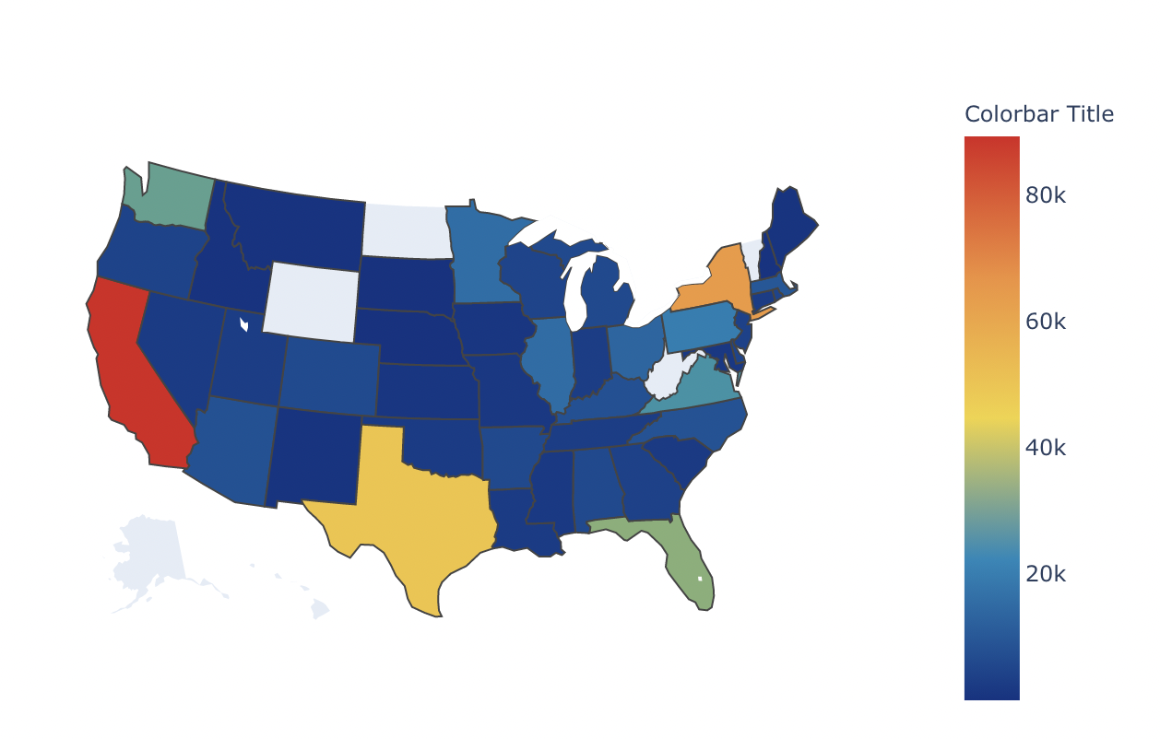
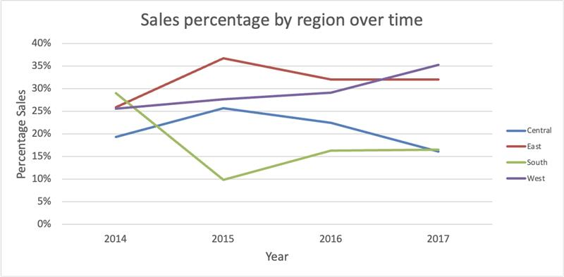
West and East are contributing most to overall sales
Total Sales by region
Insights:
Sales in west showing an upward trend making it to the highest contributor by 2017 end
Sales in East has been stagnant over the year
New-York and California are the most contributing states to the overall sales

Slide 12
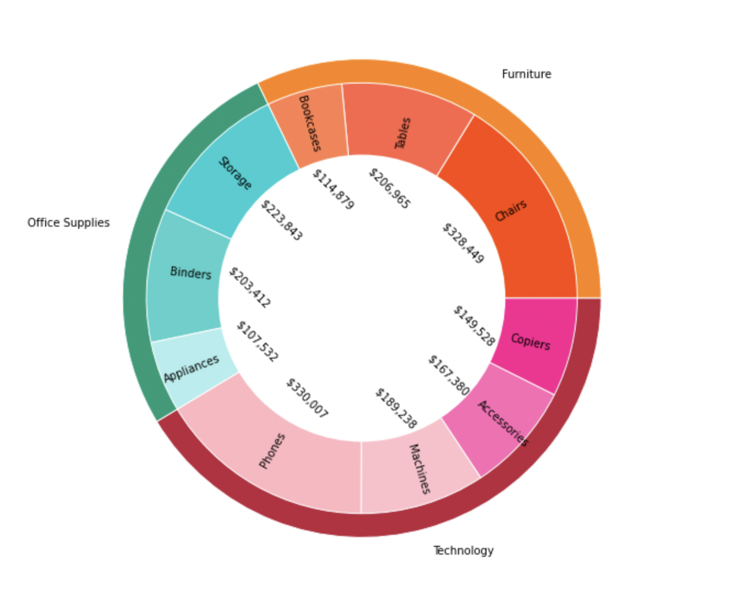
Phones & chairs are top selling subcategories
Sales are uniform across categories with technology having marginally higher sales
Phones are the highest selling subcategory under Technology with 39.47% contribution
Storage is the highest selling subcategory in Office supplies with 31.13% contribution
In case of Furnitures, Chairs have the highest sales with 44.27% contribution.

Slide 13
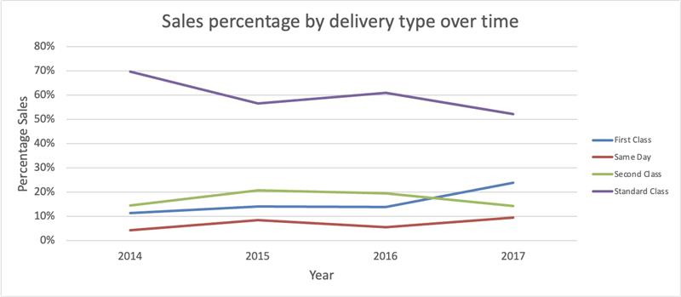
Percentage of first-class delivery mode have more than doubled in the last four years
Standard delivery mode has the highest overall sales
Percentage of first-class delivery mode have more than doubled
Company can capitalize their First class and Same day delivery modes

Slide 14
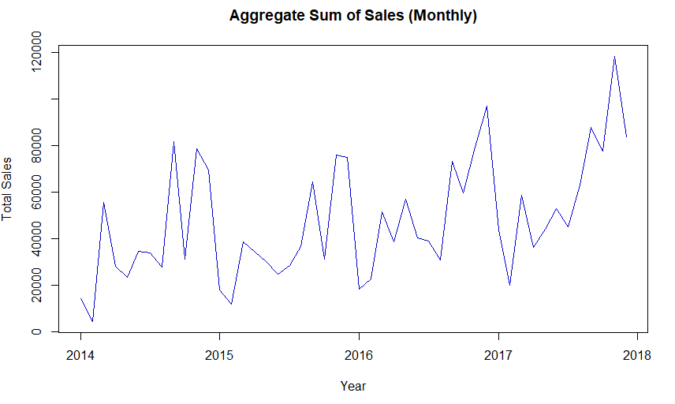
Data Cleaning and Processing
No Missing values
Removed the Outliers
Changed the date format
Aggregated the data at Monthly level
Box-Cox Transformation

Slide 15
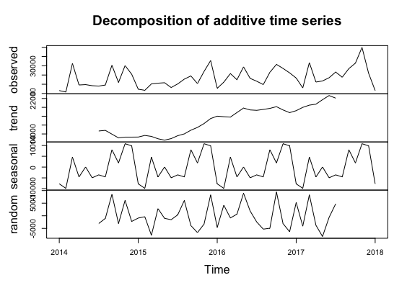
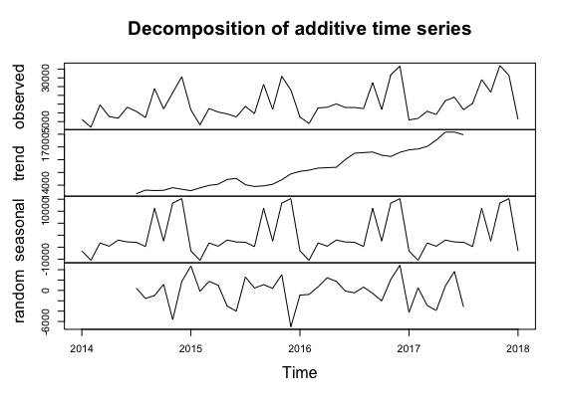
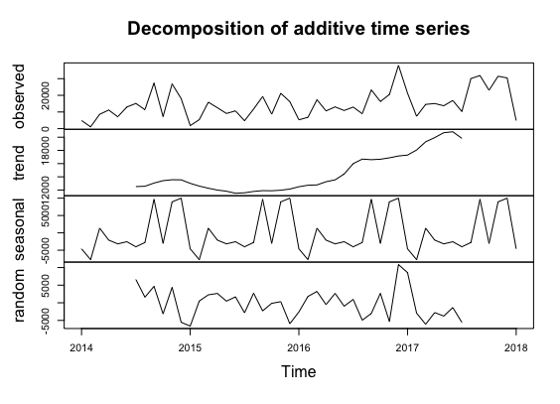
Data Modelling
Technology
Furniture
Office Supplies
Segregated the sales data into the Categories – Office Supplies, Furniture and Technology as Sales of the product categories are behaving differently over time
For all the categories – Time series data created with training and validation sets
Sales forecasted for a year utilizing forecasting methods: ARIMA, Auto ARIMA, Holt-Winter’s, Naïve, Moving Average
Notes:
Suppliers are different for different products

Slide 16
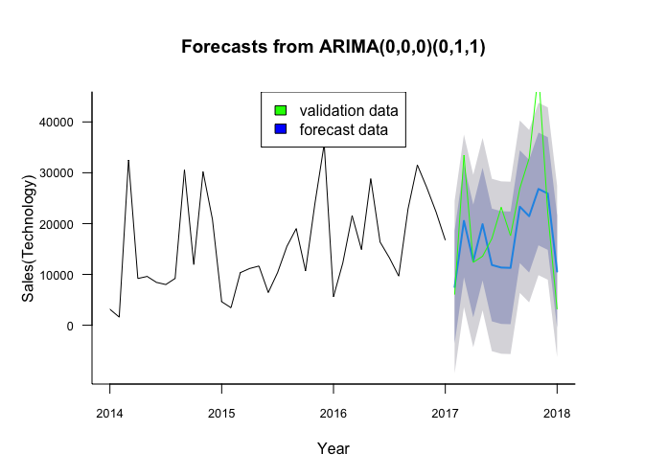
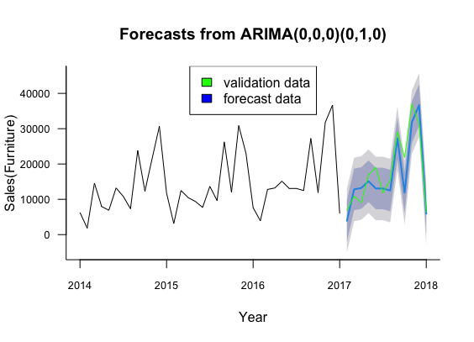
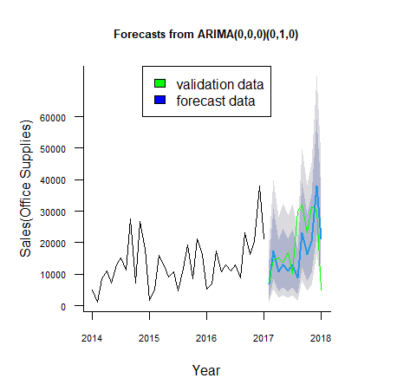
Data Evaluation
 | Arima | Auto ARIMA | Holt-Winter's
Training set | 22.945 | 32.766 | 21.689
Test set | 33.153 | 50.342 | 35.631
 | ARIMA | Auto ARIMA | Holt -Winter's
Training set | 16.846 | 13.236 | 16.317
Test set | 22.103 | 27.397 | 28.990
 | ARIMA | Auto ARIMA | Holt -Winter’s
Training set | 30.047 | 33.676 | 44.342
Test set | 54.048 | 59.867 | 72.705

Slide 17
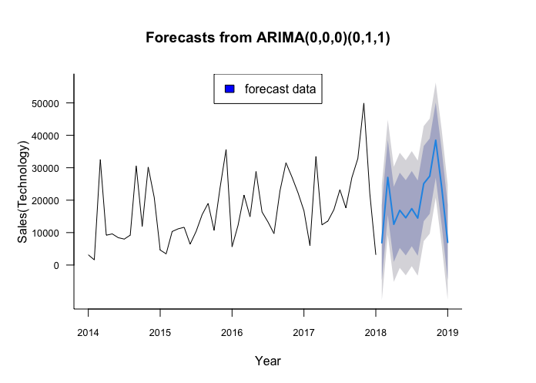
Sales Forecast- Technology
Insights
Drastic increase
in sales expected
at start and end
of the year
Drop in sales
towards the mid
of the year

Slide 18
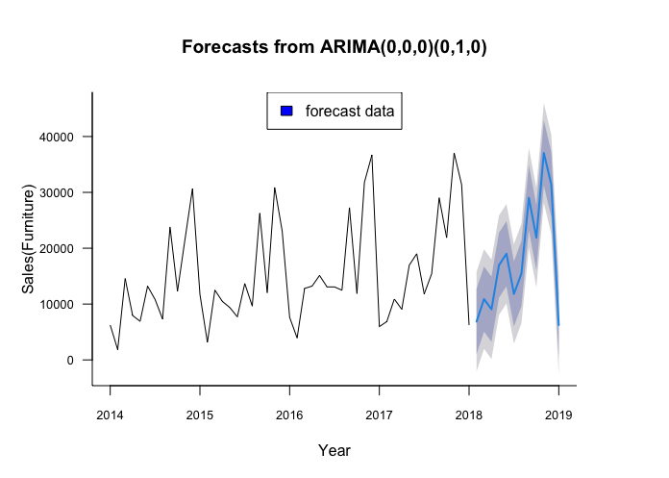
Sales Forecast- Furniture
Insights
Demand increases steadily throughout the year
Expected drastic
drop at the end of
next year

Slide 19
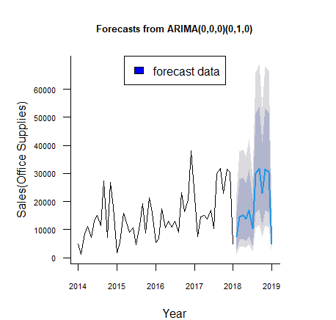
Sales Forecast- Office Supplies
Insights
Increasing demand
Peak expected at
the mid of year
Dip in sales
expected at the
end of year

Slide 20
04. Recommendations

Slide 21
Recommendations
Replicate forecasting based on sales region to plan and optimize the delivery time ahead
Use accurate sales forecasting to manage inventory and lower the operations costs
Collect more data to understand any external influence on sales like holidays, inflation, promotions, etc.
Understanding market share and competitive advantage can help improve the forecasting
Focusing and promoting the first class and same day will help the company achieve higher revenue growth rate

Slide 22
THANKS!

